Slide 1
CLASSIFICATION
Main reference: Chapter 3 of Géron, A. (2019). Hands-on machine learning with Scikit-Learn, Keras, and TensorFlow.

Slide 2


MNIST dataset
A set of 70,000 small images of digits (0-9) handwritten by high school students and employees of the US Census Bureau.
Each image is labeled with the digit it represents.

Slide 3
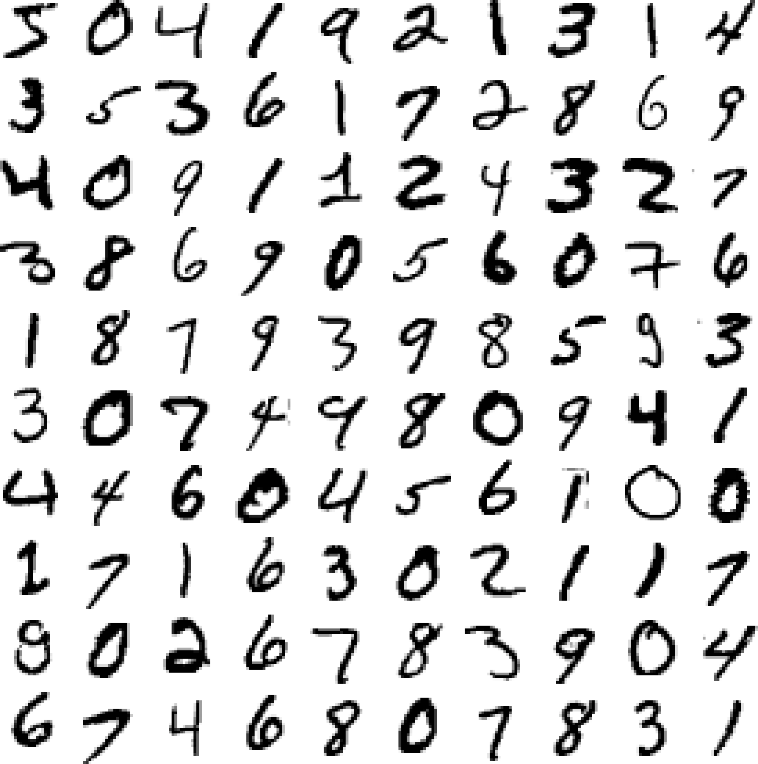





Image: (Géron, 2019)

Slide 4
Go to: Chap03_Classification.py

Slide 5






Stochastic Gradient Descent (SGD)

Slide 6







Confusion matrix

Slide 7








Precision and recall

Slide 8













Precision/Recall tradeoff

Slide 9
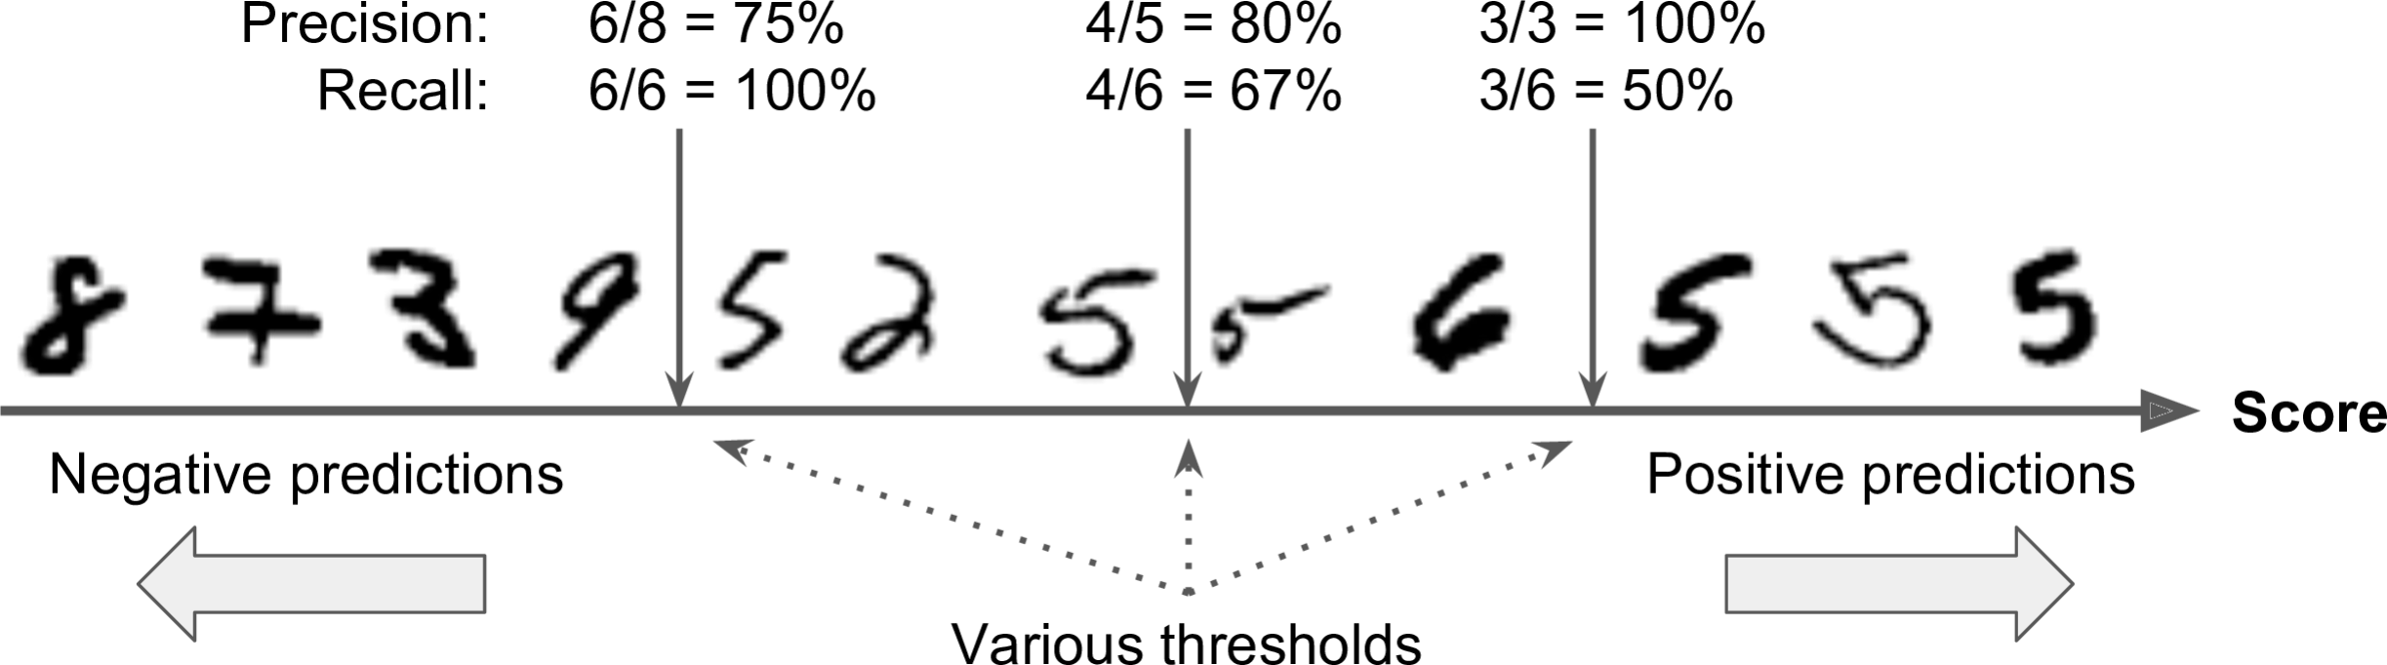
Precision/Recall tradeoff
Source: (Géron, 2019)

Slide 10
F1-score
F1 = 2 × precision × recall / (precision + recall)

Slide 11



ROC curve

